Slide 1
Sharing experience in auditing the Sustainable Development Goals 1st EUROSAI – AFROSAI SEMINAR Lisboa, November 2019
Marian Banaś, President of NIK
Notes:
.

Slide 2
Introduction
Constitution of the Republic of Poland: sustainable development is one of priorities and the government is obliged to implement the concept
September 2015: 193 United Nations countries, including Poland, adopted a resolution: Transforming our world the 2030 Agenda for Sustainable Development, containing 17 Sustainable Development Goals (SDG)
February 2017: Council of Ministers of Poland adopted a resolution on the Responsible Development Strategy

Slide 3
Added Value of the Audit of the 2030 Agenda
NIK has an important role in the monitoring of the implementation of progress towards achieving the United Nations’ Sustainable Development Goals, in line with ISSAI 5130 "Sustainable Development: the Role of SAIs"
NIK’s involvement in national and international fora as an institution that actively supports implementation of the 2030 Agenda, by identifying problems and good practices, in line with ISSAI 12 „Values and Benefits of SAIs – making a difference to the lives of citizens"

Slide 4
Added Value of the Audit of the 2030 Agenda
NIK received information about the sources and nature of problems related to preparations for the implementation of the 2030 Agenda
NIK suggested areas that require intensified government attention to ensure effective and coherent achievement of the 2030 Agenda goals

Slide 5
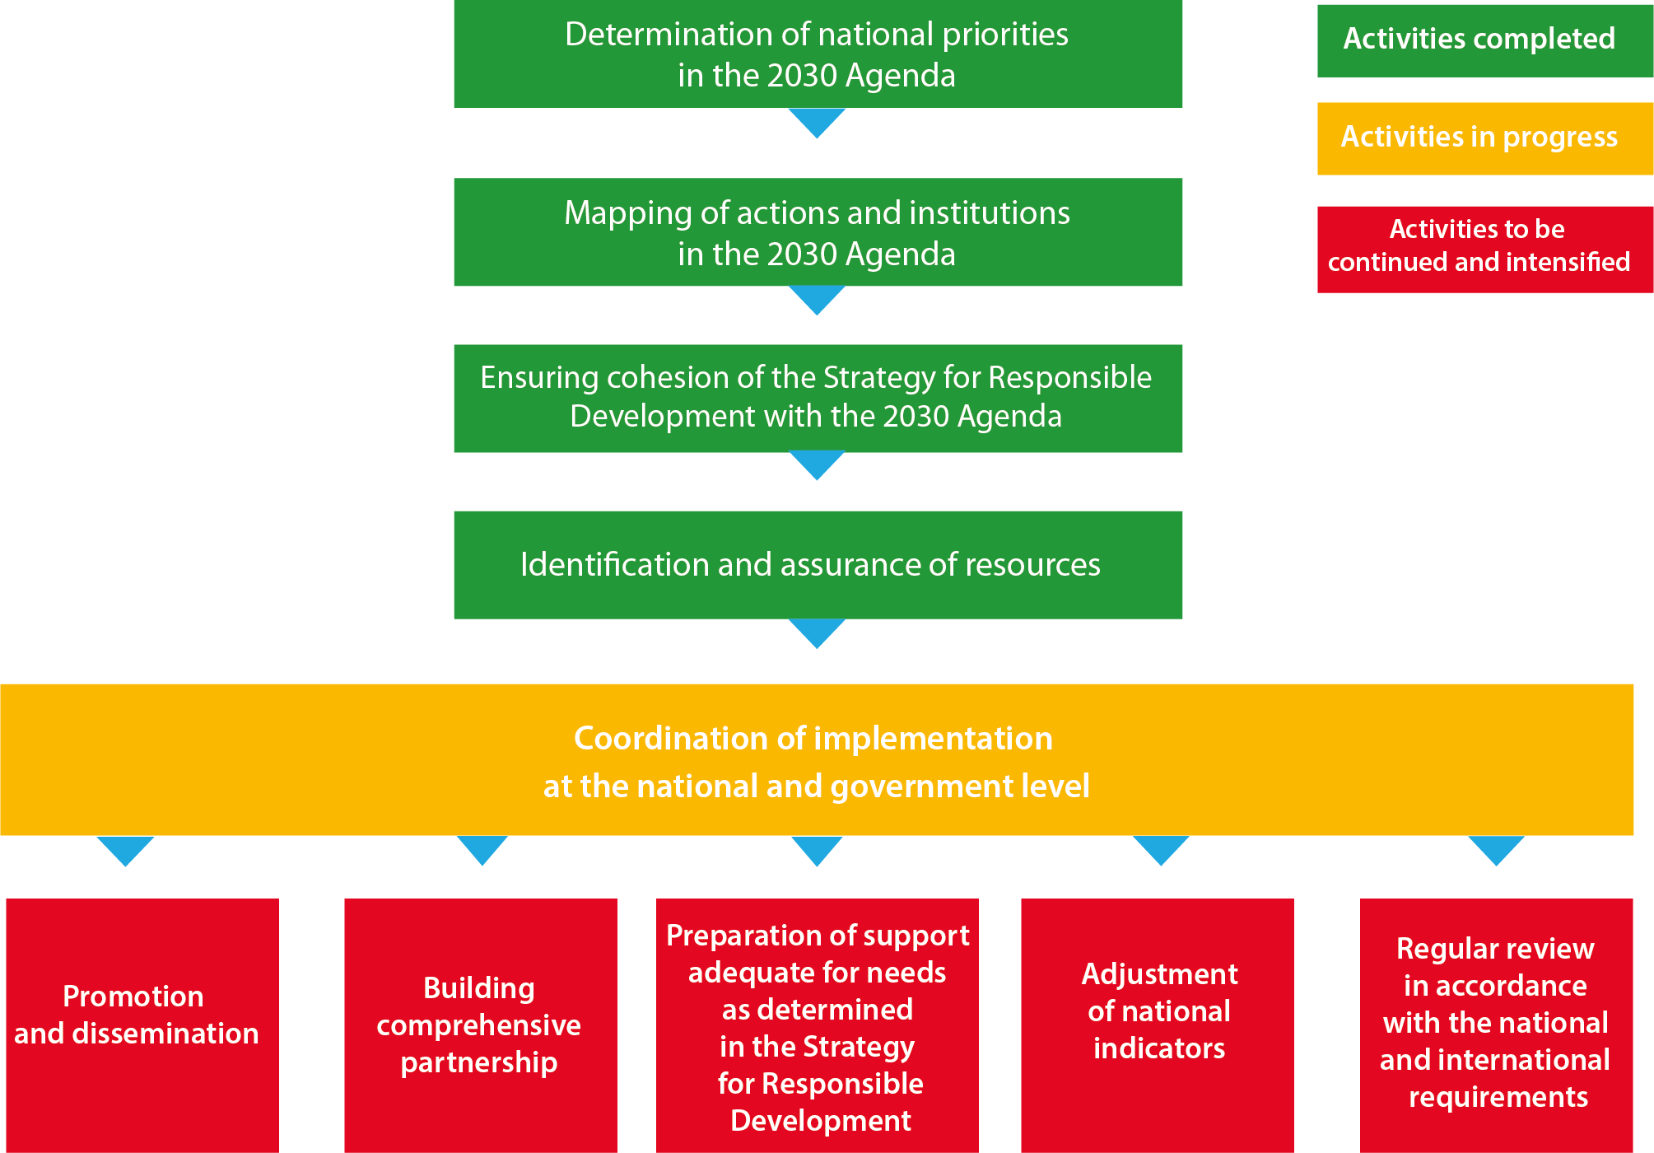
Audit at a Glance

Slide 6
NIK Recommends
Promotion of 2030 Agenda and dissemination of SDGs should be intensified in different environments and social groups
Information on Agenda 2030 should be published on websites of ministries and offices
Socio-institutional partnership should be established for Agenda 2030 implementation and further intensified, and include all stakeholders possible
Measures offered for declining cities should be promoted, so that more cities apply for support
Support offer for the declining cities should be further adjusted

Slide 7
NIK Recommends
National indicators should be compliant with the indicators adopted by the UN, so as to allow for measuring progress and regular assessment of the country's performance, also on the international arena
Following the voluntary review of 2018, regular reviews of progress at the national and local level should be continued, so as to add to the society’s interest in SDGs

Slide 8
Lessons Learned – Examples of Good Practices in Other Countries
Extended integrated approach at the local level through voluntary inclusion of activities of local government units
Raising public awareness of the implementation of the SDGs of 2030 Agenda

Slide 9
